Slide 1

Bachelor of Engineering
Project presentation
Department of Electronics & Telecommunicatin Engineering
Shree L R Tiwari College of Engineering
Kanakia Park, Mira Road (E), Mumbai-401107
UNIVERSITY OF MUMBAI
2024-2025

Slide 2
A PRESENTATION ON
“TOUCH SCREEN BASED AUTOMATION SYSTEM”
By
AYUSH PIMPARKAR
NOVMAN SHAIKH
SAURABH YADAV
AKHLAD AL-QURAYSH
Under the guidance of
Mrs. SHRUTI PATIL

Slide 3
Contents
Problem Statement
Abstract
Literature Survey
Introduction
Block diagram
Circuit Diagram
Working
Hardware & Software components
Expected Result
Future Scope
References

Slide 4
Problem Statement
The need for efficient home management has grown, as traditional appliance controls are cumbersome and inefficient. This project uses an Arduino Mega to develop a touchscreen home automation system, allowing users to control appliances via a smartphone app, touch sensor, and IR remote. The system provides a unified platform for simplified control, enhancing accessibility and energy efficiency.

Slide 5
Abstract
The touchscreen automation system uses an Arduino Mega to control household appliances through Bluetooth (via a smartphone app), an IR remote, and a touch sensor. A 4-channel relay module manages appliances like lights, a fan, and a socket. App allows control via buttons or voice commands, providing a versatile and convenient home automation solution.

Slide 6
Literature Survey
Year of publication | Author | Publication Paper | Application
February 2021 | Samruddhi Fasi , Neha Khanaj, Pratiksha Lokare, Poorva Shreshthi, Ms.R.R.Gaji | Home automation system | The GSM-based system enables remote control of home appliances via smartphone, enhancing convenience and security.
April 2019 | Kondapalli Jayaram Kumar, Chodisetti Venkata Balaji, Sukkireddy V V Manikanta Swamy Naidu, Vendra Vamsidhar, Desaneedi Satish | CAPSENSE BASED TOUCH PANEL CONTROLLED HOME AUTOMATION | The Capsense-based system enables touch and app-based control of home appliances via IoT, providing convenience and accessibility for all users.
November 2018 | Prof.Ami Munshi, Roshan Gosalia(Student), Darshil Gala(student | Android Based Home Automation System | This application demonstrates the integration of mobile technology with home electronics, providing a step towards creating a more connected and efficient living environment.
March 2018 | Prof. Manohar Wagh,Vrushabh Gadhari,Harshad Sonawane, Shriram Shekar , Rahul Mahala. | Touch screen based automation system | This system aims to provide a user-friendly, secure, and efficient way to manage various aspects of a home environment through a centralized touch screen interface.
June 2014 | Mr.Yash Inaniya, Naresh Kumari and Urvashi Luthra. | Automation System using capacitive screen | The paper emphasizes that this system is designed to be cost-effective, using readily available materials, and can be expanded to control more devices beyond the four demonstrated in the project

Slide 7
Introduction
The evolution of smart home technologies has brought convenience, safety, and energy efficiency to our daily lives. This project presents a touchscreen automation system controlled by an Arduino Mega, which integrates multiple control methods—smartphone app, touch sensor, and IR remote—to manage household appliances. The system aims to make home management more accessible, flexible, and convenient by combining different control interfaces in one automation solution.

Slide 8
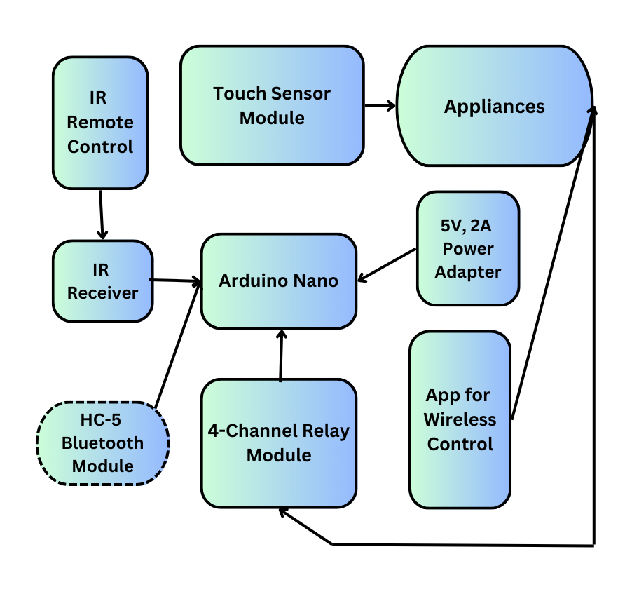
Block Diagram

Slide 9
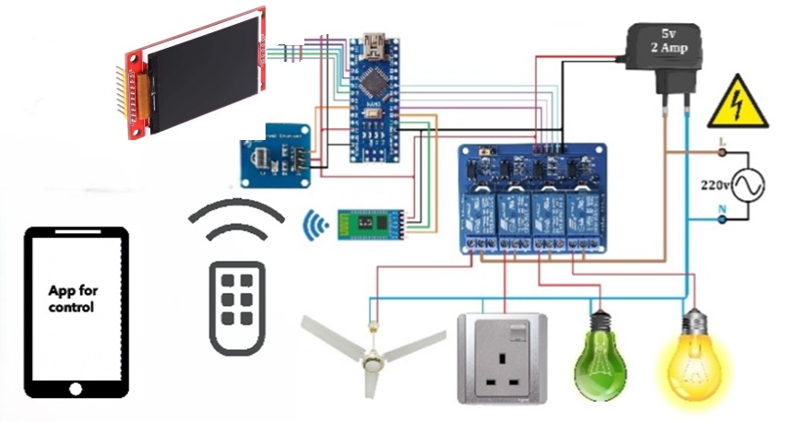
Circuit Diagram

Slide 10
Working
The touchscreen automation system is controlled by an Arduino Mega and allows users to manage household appliances in multiple ways—via a smartphone app, a touch sensor, or an IR remote. The Arduino receives control commands from a Bluetooth module, touch sensor, or IR receiver, processes them, and then activates the corresponding relay to control AC appliances like lights, fans, and sockets. The relay module, powered by a 5V adapter and connected to the 220V AC mains, switches these appliances on or off as directed. The smartphone app, offers an easy-to-use interface with buttons and voice commands for seamless control. This setup provides a convenient and flexible way to manage household devices, integrating both wireless and direct manual inputs.

Slide 11
Hardware & Software Requirements
Component | Description
Arduino Atmega 2560 Rev3 | For wireless communication and control.
4-Channel Relay Module | To control 2 fans and 2 bulbs.
TFT Touch Display | For touch-based control of appliances.
HC-05 Bluetooth Module | Enables wireless serial communication.
IR Receiver | Receives signal from IR remote
IR Remote Control | Sends commands to control appliances
Power Supply (5V, 2A) x2 | To power the ESP32 circuits and relays.
Connectors and Wires | For connecting components.
Appliances x4 | Appliances to be controlled.
Arduino IDE | For programming the modules.

Slide 12
Expected Result
Provide real-time control of two bulbs, a Fan and a Power Socket through the TFT touch display ,voice commands ,Smartphone app and IR remote
Offer users flexible control options with quick response times.
Function reliably across different conditions, making it suitable for home Applications

Slide 13
Future Scope
Expanded Appliance Control: The system can be scaled to control more devices, including additional home appliances.
Energy Monitoring: Integrate energy consumption tracking to optimize power usage for connected devices.
AI-Based Voice Recognition: Integrating advanced AI voice recognition could improve accuracy and enable more complex voice commands.

Slide 14
References
[1] Mr.Yash Inaniya, Naresh Kumari and Urvashi Luthra “Home automation using capacitive touchscreen”,June 2014, al Int. Journal of Engineering Research and Applications ISSN : 2248-9622, Vol. 4, Issue 6( Version 2)
[2] Prof.Manohar Wagh, Vrushabh Gadhari, Harshad Sonawane, Shriram Shelar, Rahul Mahale “touch screen based automation system”,March 2018, at International Research Journal of Engineering and Technology(IRJET)
[3] Prof.Ami Munshi,Roshan Gosalia,Darshil Gala, “android based automation system”,November 2018, at International Journal of Scientific & Engineering Research Volume 9, Issue 11
[4] Er.VikramPuri, IEEE, “Real Time Smart Home Automation based on PIC Microcontroller, Bluetooth and Android Technology”, March 2016, At faculty- Embedded System & Robotics, Enjoin Technologies.

Slide 15
THANK YOU

